Slide 1
chapter 20
ubiquitous computing and augmented realities

Slide 2
ubiquitous computing and augmented realities
ubiquitous computing
  filling the real world with computers
virtual and augmented reality
  making the real world in a computer!

Slide 3
Challenging HCI Assumptions
What do we imagine when we think of a computer?
“The most profound technologies
are those that disappear.”
Weiser
1990’s: this was not our imagined computer!

Slide 4
Ubiquitous Computing
Any computing technology that permits human interaction away from a single workstation
Implications for
  Technology defining the interactive experience
  Applications or uses
  Underlying theories of interaction

Slide 5
Scales of devices
Weiser proposed
  Inch
  Foot
  Yard
Implications for device size as well as relationship to people

Slide 6
Device scales
Inch
  PDAs
  PARCTAB
  Voice Recorders
  smart phones
Individuals own many
of them and they can all communicate with each other and environment.

Slide 7
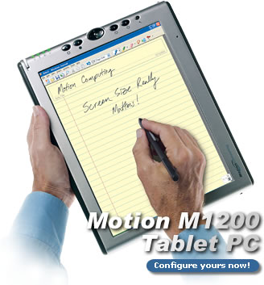
Device scales
Foot
  notebooks
  tablets
  digital paper
Individual owns several but not assumed to be always with them.

Slide 8
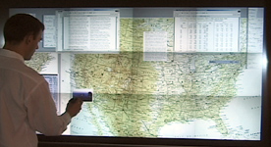
Device scales
Yard
  electronic whiteboards
  plasma displays
  smart bulletin boards
Buildings or institutions own them and lots of people share them.

Slide 9
Defining the Interaction Experience
Implicit input
  Sensor-based input
  Extends traditional explicit input (e.g., keyboard and mouse)
  Towards “awareness”
  Use of recognition technologies
  Introduces ambiguity because recognizers are not perfect

Slide 10
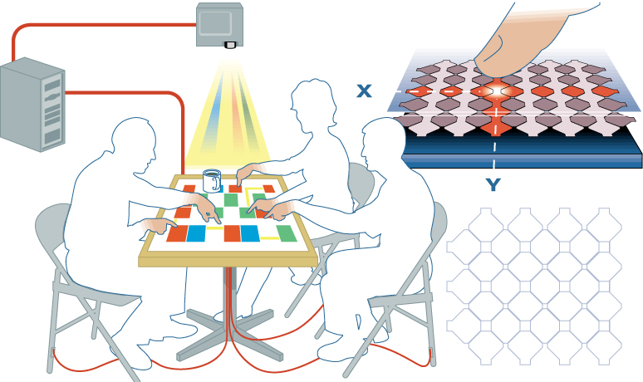
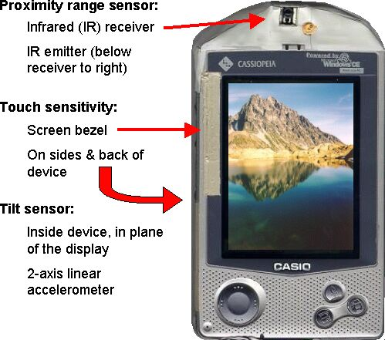
Different Inputs
Capacitive sensing on a table
Sensors on a PDA

Slide 11
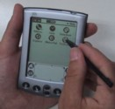
Multi-scale and distributed output
Screens of many sizes
  (very) small
  (very) large
Distributed in space, but coordinated

Slide 12
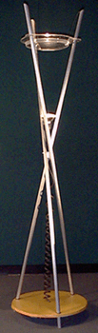
The output experience
More than eye-grabbing raster displays
  Ambient: use features of the physical environment to signal information
  Peripheral: designed to be in the background
Examples:
  The Dangling String
  The Water Lamp (shown)

Slide 13
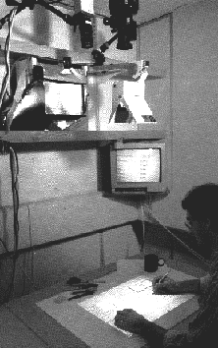
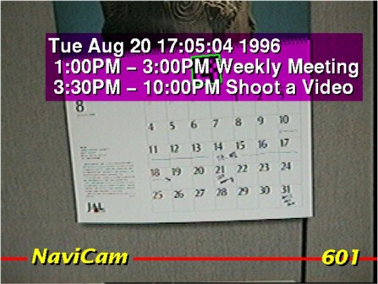
Merging Physical and Digital Worlds
How can we remove the barrier?
  Actions on physical objects have meaning electronically, and vice versa
  Output from electronic world superimposed on physical world
A “digital” desk
An augmented calendar

Slide 14
Application Themes
Context-aware computing
  Sensed phenomena facilitate easier interaction
Automated capture and access
  Live experiences stored for future access
Toward continuous interaction
  Everyday activities have no clear begin-end conditions

Slide 15
New Opportunities for Theory
Knowledge in the world
  Ubicomp places more emphasis on the physical world
Activity theory
  Goals and actions fluidly adjust to physical state of world
Situated action and distributed cognition
  Emphasizes improvisational/opportunistic behavior versus planned actions
Ethnography
  Deep descriptive understanding of activities in context

Slide 16
Evaluation Challenges
How can we adapt other HCI techiques to apply to ubicomp settings?
  Ubicomp activities not so task-centric
  Technologies are so new, it is often hard to get long-term authentic summative evaluation
  Metric of success could be very different (playfulness, non-distraction versus efficiency)

Slide 17
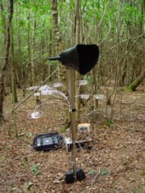
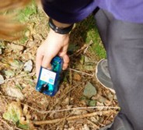
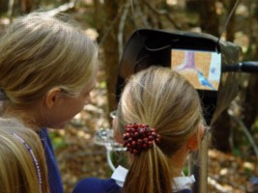
ambient wood
real wood! … filled with electronics
light and moisture meters
  recorded with GPRS location
  drawn on map later
‘periscope’
  shows invisible things
  uses RFID
triggered sound

Slide 18
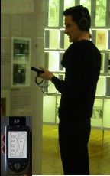
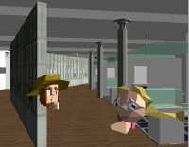
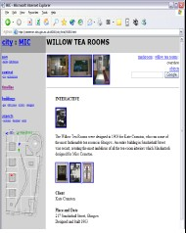
City - shared experience
visitors to Mackintosh Interpretation Centre
  some on web, some use VR, some really there
interacting
  talk via microphones
  ‘see’ each other virtually
different places
different modalities
shared experience

Slide 20
virtual and augmented reality
VR - technology & experience
web, desktop and simulators
AR – mixing virtual and real

Slide 21
virtual reality technology
headsets allow user to “see” the virtual world
gesture recognition achieved with DataGlove (lycra glove with optical sensors that measure hand and finger positions)
eyegaze allows users to indicate direction with eyes alone
whole body position sensed, walking etc.

Slide 22

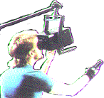

VR headsets
small TV screen for each eye
slightly different angles
3D effect

Slide 23
immersion
VR
  computer simulation of the real world
    mainly visual, but sound, haptic, gesture too
  experience life-like situations
    too dangerous, too expensive
  see unseen things:
    too small, too large, hidden, invisible
      e.g. manipulating molecules
the experience
  aim is immersion, engagement, interaction

Slide 24
on the desktop
headset VR
  expensive, uncomfortbale
desktop VR
  use ordinary monitor and PC
    cheap and convenient
in games …
and on the web
  VRML – virtual reality markup language

Slide 25
VRML … VR on the web
#VRML V1.0 ascii
Separator {
Separator { # for sphere
Material {
emmissiveColor 0 0 1 # blue
}
Sphere { radius 1 }
}
Transform { translation 4 2 0 }
Separator { # for cone
Texture2 {
filename "big_alan.jpg"
}
Cone {
radius 1 # N.B. width=2*radius
height 3
} } }

Slide 26
command and control
scenes projected on walls
realistic environment
hydraulic rams!
real controls
other people
for:
  flight simulators
  ships
  military

Slide 27
augmented reality (AR)
images projected over the real world
  aircraft head-up display
  semi-transparent goggles
  projecting onto a desktop
types of information
  unrelated – e.g. reading email with wearable
  related – e.g. virtual objects interacting with world
issues
  registration – aligning virtual and real
  eye gaze direction

Slide 28
applications of AR
maintenance
  overlay instructions
  display schematics
examples
  photocopier engineers
    registration critical arrows point to parts
  aircraft wiring looms
    registration perhaps too hard, use schematic

Slide 29
applications of VR
simulation
  games, military, training
VR holidays
  rainforest, safari, surf, ski and moon walk
  … all from your own armchair
medical
  surgery
    scans and x-rays used to build model
    then ‘practice’ operation
    force feedback best
  phobia treatment
    virtual lifts, spiders, etc.

Slide 30
information and data visualisation
VR, 3D and 2D displays
scientific and complex data
interactivity central

Slide 31
scientific and technical data
number of virtual dimensions that are ‘real’
three dimensional space
  visualise invisible fields or values
  e.g. virtual wind tunnel
two dimensional space
  can project data value up from plane
  e.g. geographic data
  N.B. viewing angle hard for static visualisation
no ‘real’ dimensions
  2D/3D histograms, scatter plots, pie charts, etc.

Slide 32
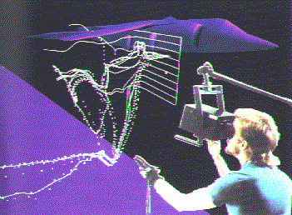
virtual wind tunnel
fluid dynamics to simulate air flow
virtual bubbles used to show movements
‘better’ than real
wind tunnel …
  no disruption of
  air flow
  cheaper and faster

Slide 33
structured informnation
scientific data – just numbers
information systems … lots of kinds of data
hierarchies
  file trees, organisation charts
networks
  program flow charts, hypertext structure
free text …
  documents, web pages

Slide 34
visualising hiererchy
2D organisation chart
  familiar representation
  what happens when it gets wide?
managing
director
sales
manager
marketing
manager
production
manager
F. Bloggs
F. Bloggs
A. Jones
R.Carter
K. West
B. Firth
J. Smith
P. Larkin

Slide 35
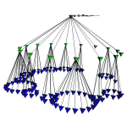
wide hierarchies … use 3D?
managing
director
sales
manager
marketing
manager
production
manager
F. Bloggs
F. Bloggs
A. Jones
R.Carter
K. West
B. Firth
J. Smith
P. Larkin
cone trees (Xerox)
levels become rings
overlap ‘OK’ in 3D

Slide 36
networks in 2D
network or ‘graph’:
  nodes – e.g. web pages
  links – may be directed or not – e.g. links
planar – can drawn without crossing
non-planar – any 2D layout has crossings
Planar graph
Non-planar graph

Slide 37
time and interactivity
visualising in time
  time dimension mapped to space
  changing values: sales graphs, distance-time
  events: Gantt chart, timelines, historical charts
    e.g. Lifelines – visualising medical and court records
using time
  data dimension mapped to time
  time to itself: fast/slow replay of events
  space to time: Visible Human Project
interactivity
  change under user control
    e.g. influence explorer

Slide 39
between two worlds
ubiquitous computing
  computers fill the real world
virtual reality and visualisation
  real world represented in the computer
augmented reality, ambient displays …
  physical and digital intermingled
maturity
  VR and visualisation – commonplace
  AR, ubiquity … coming fast!

